Slide 1
Gesture Remote Control
ECE 4180 - Final Project
Project link: https://developer.mbed.org/users/sjackson64/notebook/gesture-remote-control/

Slide 2
Team members
Tue Tran (Section A)
Carden Bagwell (Section B)
Sam Jackson (Section B)

Slide 3
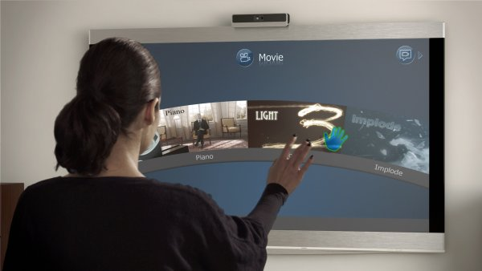
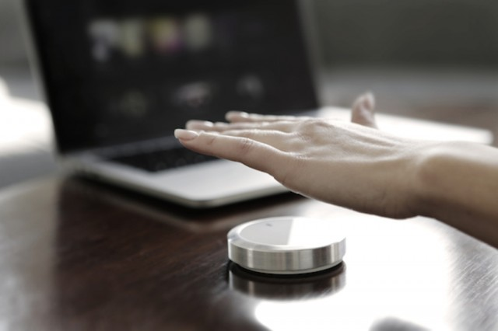
Motivation
Using hand gesture to control TV or Set-top box
Channel control
Volume control
Power (on/off) control

Slide 4
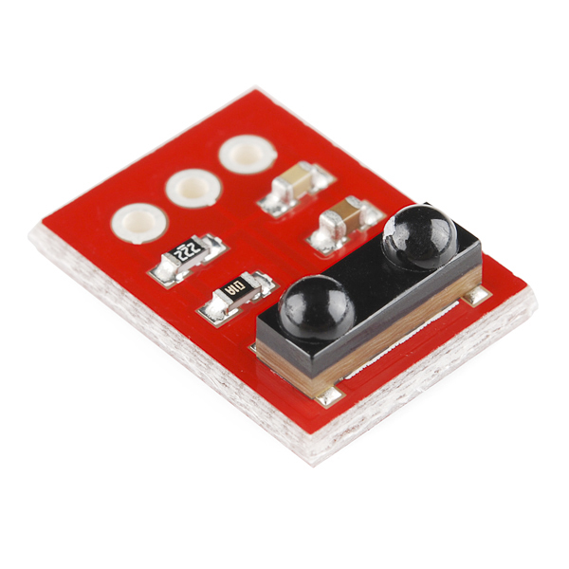
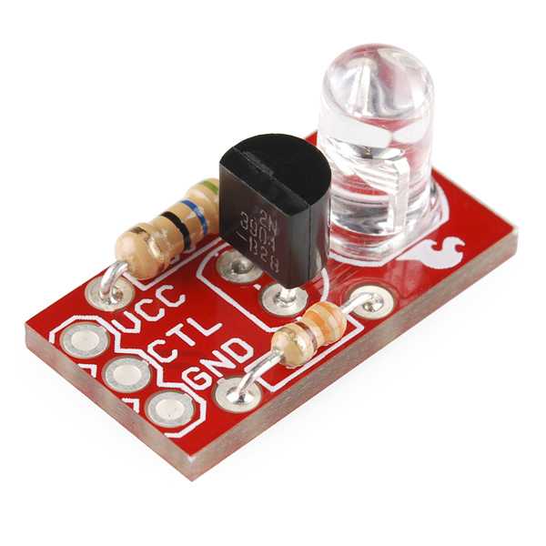
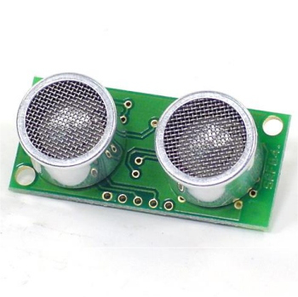
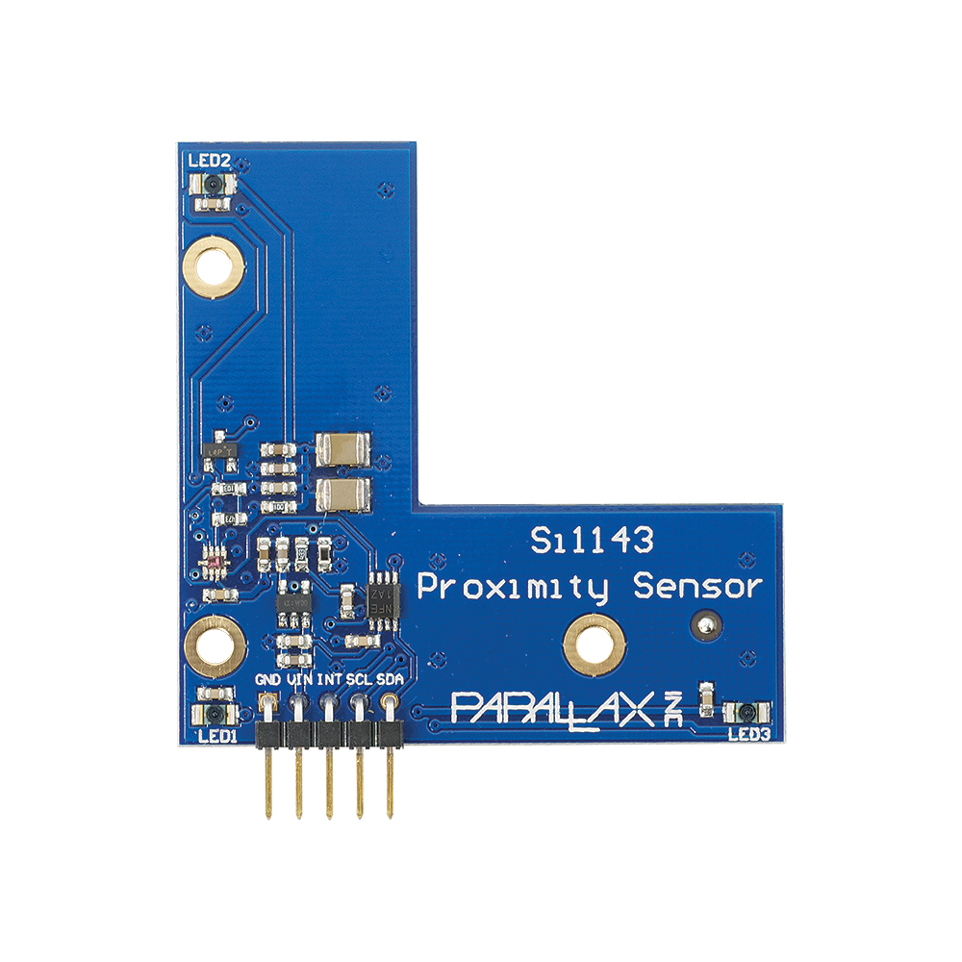
Parts
mbed NXP LPC1768
SparkFun IR receiver TSOP85
https://www.sparkfun.com/products/8554
SparkFun Power IR LED
https://www.sparkfun.com/products/retired/10732
Parallax Si1143 Gesture Sensor
https://www.parallax.com/product/28046
Polaroid Ultrasonic Ranger SRF04
http://www.robot-electronics.co.uk/htm/srf04tech.htm

Slide 5
Solution
Use the Parallax Sensor to select modes (Power, Channel, and Volume)
Hold hand above the Parallax Sensor for 3 seconds to send Power on/off signal
Hold hand above Ultrasonic Ranger to control volume and channel
Depth dictates direction, hold hand high to go up, hold hand low to go down.
Learn remote control by gathering signals with the IR receiver
Use IR Power LED to send IR signals back to the TV/Set-top box

Slide 6
Demo
https://youtu.be/ekOjm8Pc0e0

